Slide 1
Brief Summary of the Problem and Solution
identify the specific portfolio for each situation
develop a plan for how the appropriate allocation strategy may evolve in the future.
Use Dynamic Programming to identify.
Simulate different scenarios to show how the strategy will evolve
Notes:
p2 we can use Dynamic Programming to solve it backwardly to get the optimal ETF choice at each stage given the current account balance. For example, at year 1, your current account balance is $200M, then you just need to look up the table I give to you and you will find the corresponding optimal choice of ETF.

Slide 2
Current Mix
T = 10
T = 7
Wealth Level | Expected Utility | Decision
100 | -116.679 | ETF1
110 | -91.192 | ETF1
120 | -69.1821 | ETF3
130 | -49.5072 | ETF6
140 | -30.7946 | ETF7
150 | -14.0608 | ETF7
Wealth Level | Expected Utility | Decision
100 | -438.477 | ETF1
110 | -399.425 | ETF1
120 | -361.142 | ETF1
130 | -323.944 | ETF1
140 | -288.004 | ETF1
150 | -253.445 | ETF1
Notes:
Why don’t we choose ETF7?

Slide 3
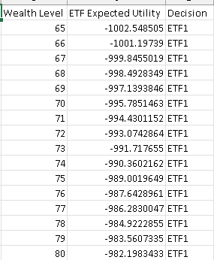
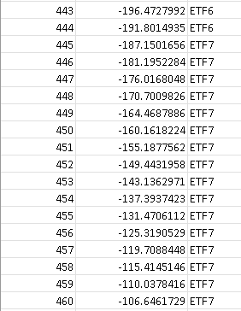
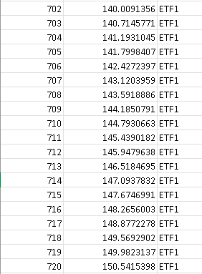
Information on future wealth and allocations
Decision Table at stage 9

Slide 4
Solving Step- Preprocessing
DEAL WITH THE RANDOMNESS
1. Calculate the covariance matrix
2. Generate 1000 scenarios for 7 assets for 10 stages.
3. Calculate 1000 scenarios for 7 ETFs for 10 stages.
4. Generate wealth range for each stages
Notes:
Generate normal distributed samples and transform it into log-normal distributed samples.

Slide 5
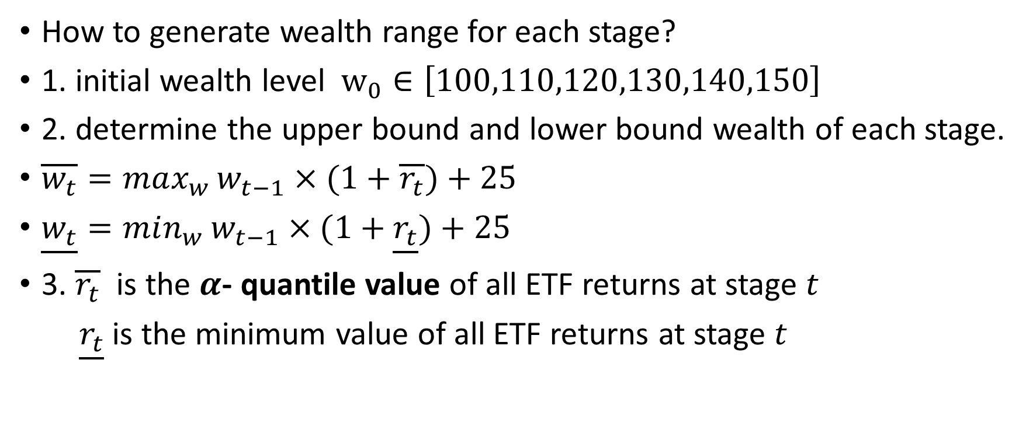
Solving Step- Preprocessing
How to generate wealth range for each stage?
1. initial wealth level $w_{0}∈\left[100,110,120,130,140,150\right]$
2. determine the upper bound and lower bound wealth of each stage.
$\overline{w_{t}}=max_{w}{w_{t−1}×(1+\overline{r_{t}})+25}$
$\underline{w_{t}}=min_{w}{w_{t−1}×(1+\underline{r_{t}})}+25$
3. $\overline{r_{t}}$ is the $α$- quantile value of all ETF returns at stage $t$
$\underline{r_{t}}$ is the minimum value of all ETF returns at stage $t$
Notes:
If we choose the maximum value of all ETF returns at stage t-1, the maximum value of the final range will be larger than 10000m, but the decision after $668M will be all the same, so I don’t think it is a good idea to choose maximum value all the time. So, I narrow down the upper bound of wealth at each stage.
I still want to cover the wealth range as large as possible, so I choose alpha as 0.9.
If I narrow down the range of wealth too much, I will lose some information about some important outliers, say if I set up the wealth range at [100,200]M $ at the stage 1, but when I simulated the final wealth , it is possible that the final wealth at the end of year1 is $300M, and I can’t find a corresponding decision in my table. If I choose a wealth level that is closest to my current wealth level, it is possible that the decision based on the table is different from the actual decision that I should have taken.

Slide 6
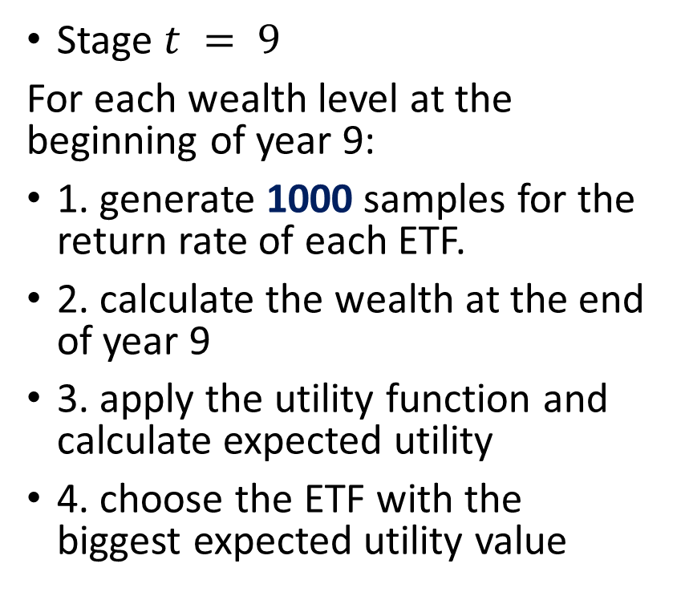
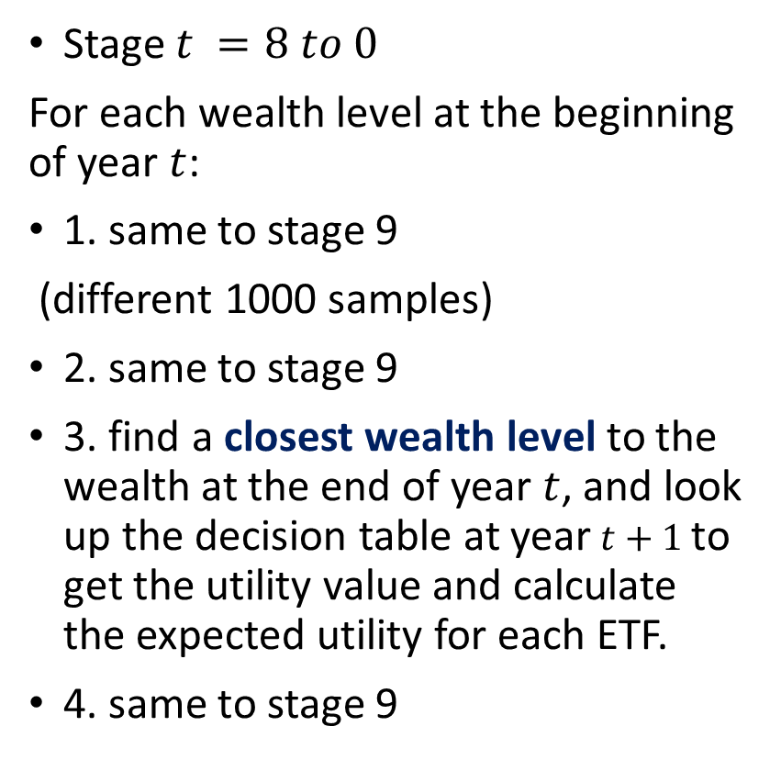
Solving Step- Dynamic Programming
Stage $t = 9$
For each wealth level at the beginning of year 9:
1. generate 1000 samples for the return rate of each ETF.
2. calculate the wealth at the end of year 9
3. apply the utility function and calculate expected utility
4. choose the ETF with the biggest expected utility value
Stage $t =8 to 0$
For each wealth level at the beginning of year $t$:
1. same to stage 9
(different 1000 samples)
2. same to stage 9
3. find a closest wealth level to the wealth at the end of year $t$, and look up the decision table at year $t+1$to get the utility value and calculate the expected utility for each ETF.
4. same to stage 9
Notes:
Use the formula
# at time stage 0-8, we can't directly apply utility function to calculate, we should instead use the recursive # relationship to find the corresponding utility value if we get the final wealth
I think 1000 samples are enough because the sample mean of each asset is approximately same to the actual mean of each asset

Slide 7

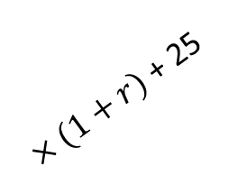
How to deal with outliers ?
$$w_{end}=300$$
$×(1+r)$ + 25
w = 200
w = 150
w = 100
T = 0
T = 1
Notes:
When we solve the dynamic programming and simulate, it is possible that the wealth at the end of one stage lies beyond our wealth range set for the next stage. And there is no corresponding decision in our table. So, my solution is eliminate these kind of scenarios when we solve the dynamic programming if the above situation happens. But if this scenario does happen in the future, I suppose you can find the closest wealth level showed in the table, and take the same decision as that wealth level. But these scenarios will be happen frequently, these are just extreme events. So you don’t need to worry much about it

Slide 8
Simulation step
1. generate 10000 samples for each ETF and the seed of the simulation samples is different from the seed of solving samples.
-Determine the ETF we should invest.
-Randomly choose a return rate of our target ETF
-Calculate the wealth at the end of the year.
2.Get a final wealth level
3. Repeat the above procedure 10000 times.
4. Analyze the statistics of all final wealth levels.
Notes:
To avoid sampling error (reduce the impact on extreme scenarios)
For example, if we choose $100M as our initial wealth, according to the decision table, we should invest ETF1 at first year. And we randomly choose one sample out of these 10000 samples for ETF1, and use that return to calculate the wealth at the end of year 0. Let’s say the wealth at the end of year 0 goes up to $110M. Then, we look up to the decision table at year1, find the corresponding decision(which ETF to invest), and continue this procedure.

Slide 9
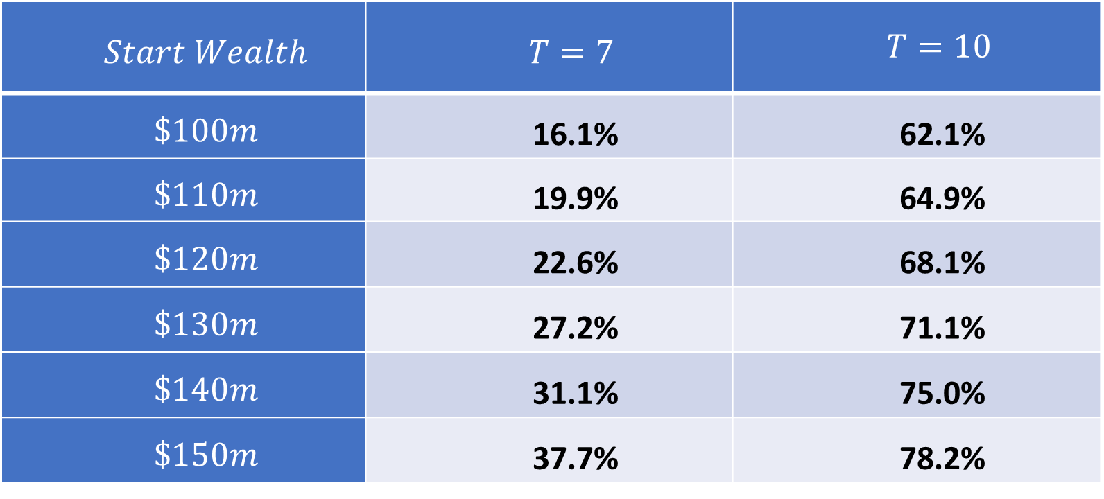
Conclusion1: the probability of have more than $500M at the time horizon
$$Start Wealth$$ | $$T=7$$ | $$T=10$$
$$\$100m$$ | 16.1% | 62.1%
$$\$110m$$ | 19.9% | 64.9%
$$\$120m$$ | 22.6% | 68.1%
$$\$130m$$ | 27.2% | 71.1%
$$\$140m$$ | 31.1% | 75.0%
$$\$150m$$ | 37.7% | 78.2%

Slide 10
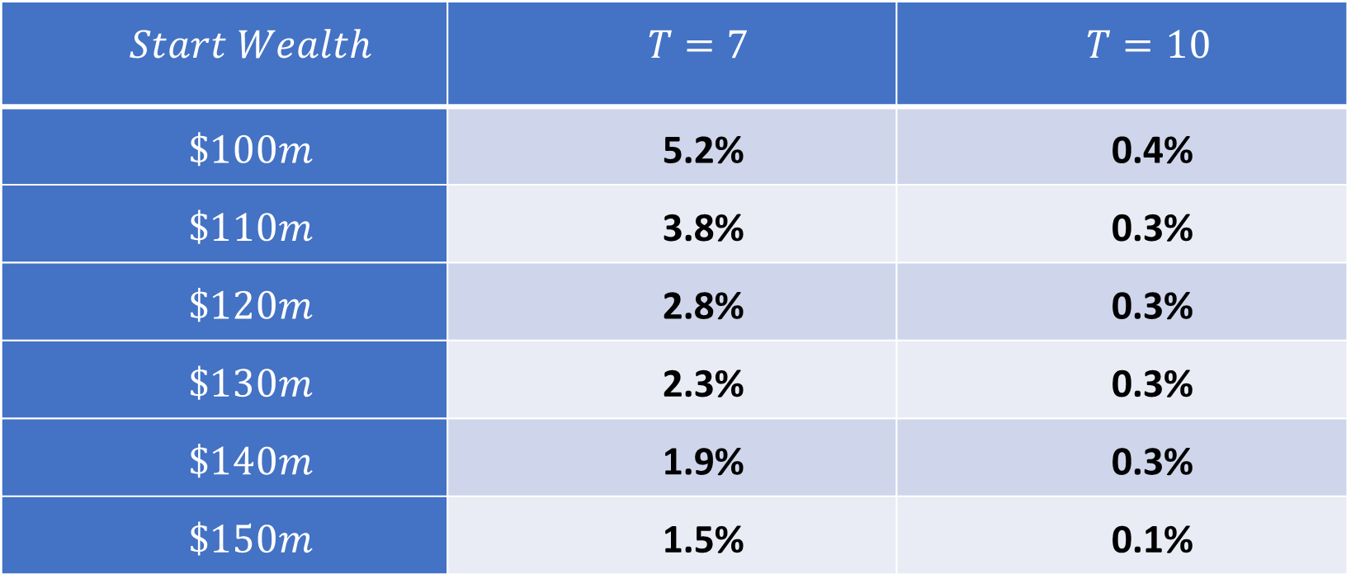
Conclusion2: the probability of have less than $200M at the time horizon
$$Start Wealth$$ | $$T=7$$ | $$T=10$$
$$\$100m$$ | 5.2% | 0.4%
$$\$110m$$ | 3.8% | 0.3%
$$\$120m$$ | 2.8% | 0.3%
$$\$130m$$ | 2.3% | 0.3%
$$\$140m$$ | 1.9% | 0.3%
$$\$150m$$ | 1.5% | 0.1%

Slide 11
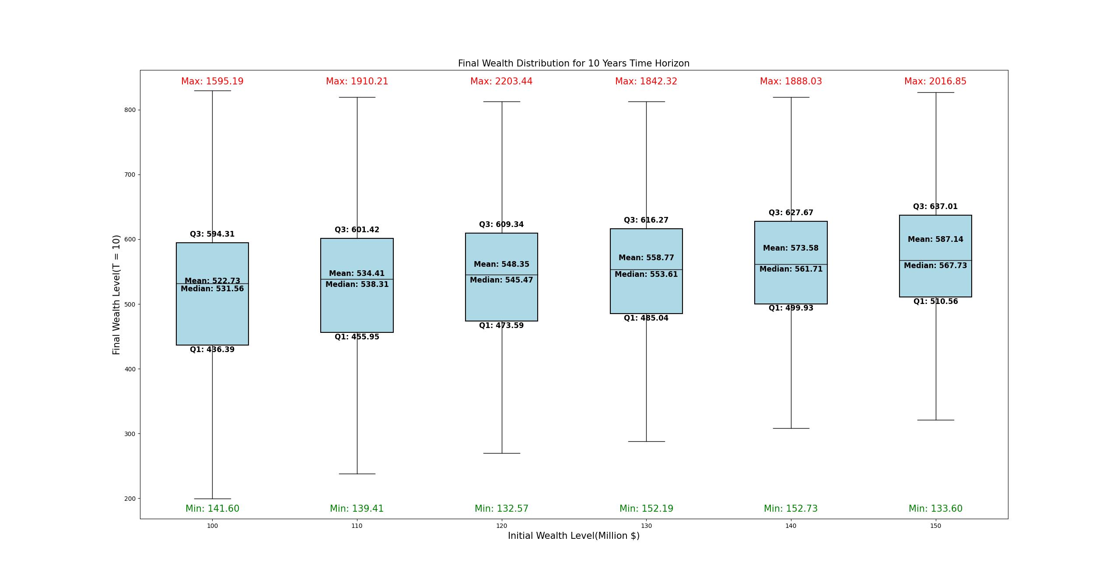
Notes:
As the initial wealth level increasing, the mean value, median value, 75th percentile and 25th percentile value are all increasing, which is corresponding to the table listed before.
I also listed the minimum and maximum given each initial wealth level, but they are just one specific path and I think we should pay more attention on the general distribution of the final wealth.
The range of the box is narrowing and I think it is because we choose to invest more conservative ETFs when the initial wealth is bigger. Because we are more likely to reach $500m at the final stage. So, generally we will encounter less extreme events.

Slide 12
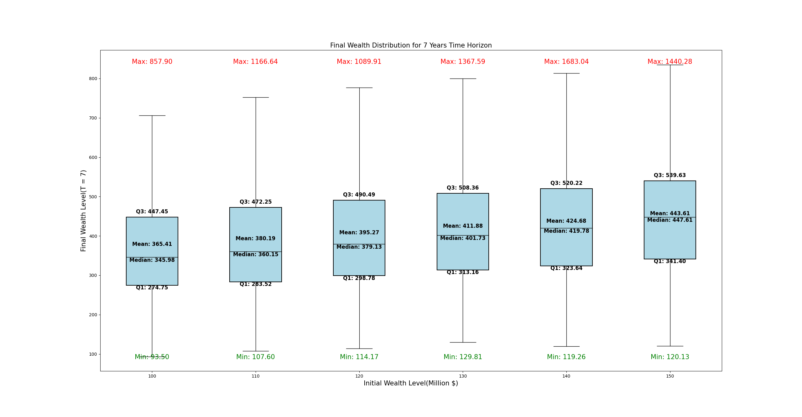
BOX PLOT FOR T = 7

Slide 13
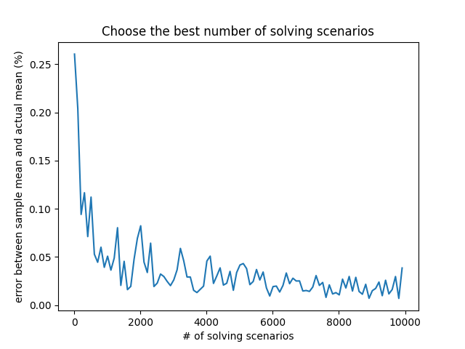
Robustness Analysis
1. solving scenarios
samples we should generate for the return rate of each ETF at each stage
Notes:
It is a tradeoff to choose a proper number of solving scenarios

Slide 14
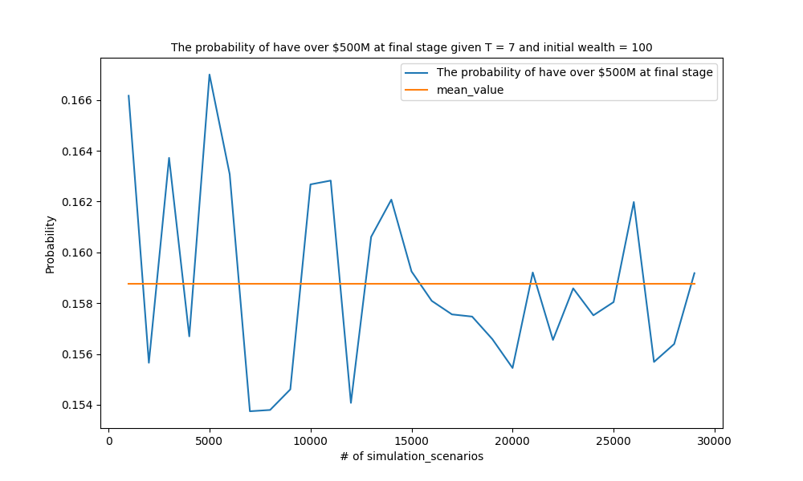
Robustness Analysis
2. Simulation scenarios

